Slide 1
Power System Planning
Lecturer 6
Prof. Dr. Muhammad Kamran
mkamran@uet.edu.pk

Slide 2
Contents
Transformers for Overhead and under ground system
Transformer voltage regulation, losses ad efficiency
Connections
Problems

Slide 3
Types of Transformers
Heat is limiting factor in transformer loading
Removing the coil heat is an important task
In liquid filled types, transformer coils are immersed in smooth surfaced, oil filled tank
Oil absorbs the coil heat and transfers it to the tank surface which, in turn, delivers it to the surrounding air
For transformers 25kVA and larger, the size of smooth tank surface required to dissipate heat becomes larger than that required to enclose the coils

Slide 4
Therefore, the transformer tank may be corrugated to add surface, or external tubes may be welded to the tank
To further increase the heat disposal capacity, air may be blown over the tube surface
Such designs are known as forced air cooled transformers
Distribution transformers can be classified as (i) Dry Type and (ii) liquid filled type
Dry type distribution transformer either air cooled or air insulated
Liquid filled type distribution transformer can be oil filled and inerteen polychlorinated biphenyl (insulation material) filled

Slide 5
Over head system Distribution transformer
Conventional transformer
Completely self protecting transformers

Slide 6
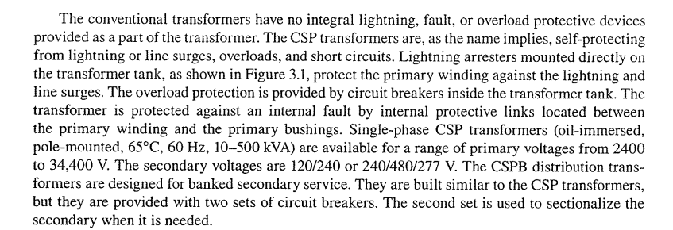

Slide 7
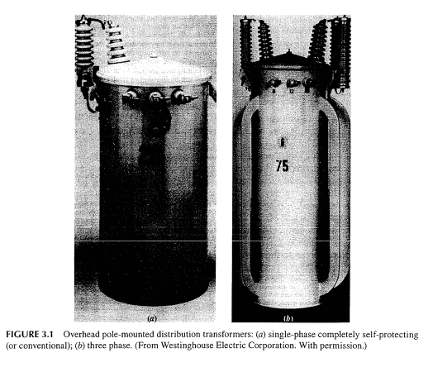

Slide 8
Completely Self Protected transformers contain several safeguards to avoid issues that would cause overloading or damage to the transformer
Conventional transformers do not have any of these features which usually means they will need to be attached to a cut out switch
The most recognizable component of a CSP transformer is the lightning arrestor
The arrestor protects against power surges caused by switching, lightning, or other high voltage sources.

Slide 9
Another component CSP transformers are fitted with is the current sensing weak link on the high voltage side
If any part of the power distribution system fails, and too much current is being drawn, this weak link will open
It provides an internal fusing as a last result to limit the transformer windings from being damaged from overdrawn currents
The last protective device on a standard CSP transformer is the low voltage breaker
This device typically has several different functions.

Slide 10
A handle is attached to allow the breaker to be manually placed in an open or closed position
The breaker will also have a float which prevents operation under low oil conditions.

Slide 11
Pad mounted distribution transformer (Specs)
These specifications cover the electrical and mechanical features of a three phase, 60 hertz, liquid-filled , self-cooled, pad-mounted compartmentalized transformer
Transformers covered by this specification shall be the standard KVA ratings of 75, 150, 300, and 750 with the high voltage windings having a basic lightning impulse insulation level (BIL) of 95KV
For three-phase transformers, the high voltage winding shall be closed DELTA and rated for 12,000 Volts line-to-line with the secondary winding configured Grounded-WYE and voltage rating of either 480/277V, 240/120V, or 208/120V

Slide 12
Transformer Temperatures
Transformers supplied shall have an average winding temperature rating of 65/75°C
The average winding temperature and oil temperature near the top of the transformer tank shall not exceed 65°C when loaded at base kVA rating
Additionally, under continuous operations at the transformer’s rated kVA, no hot-spot windings shall exceed a 90°C rise over ambient
The transformer shall provide an additional 12% capacity at the 75°C rating

Slide 13
Transformer percent impedance values shall not be less than the following: -
75 kVA 2.7% -
150 kVA 3.1% -
300 kVA 3.1% -
750 kVA 4.4%

Slide 14
Protection equipment
Each transformer shall be supplied with one oil-immersed partial range current limiting fuse(s) per phase
The current limiting fuse manufacturer and catalog information shall be identified on the transformer nameplate
The bayonet fuses shall be installed in series with current limiting fuses, inserted between the transformer winding and the high voltage bushing
These bayonet fuses shall be installed in series with the current limiting fuses, inserted between the transformer winding and the high voltage bushing

Slide 15
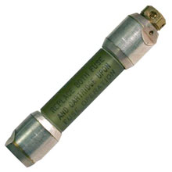
Bayonet fuse
Bay-O-Net assemblies to protect distribution apparatus from damaging currents and to protect distribution systems

Slide 16
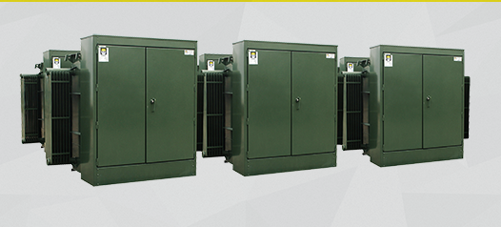

Slide 17
The distribution transformers employed for underground distribution systems can be categorized as;
Subway transformers, Low cost residential transformers and network transformers
Subway transformers are used in underground vaults
They can be conventional type or current protected type
Low cost residential transformers are same as conventional type employed on overhead system

Slide 18
Network transformers are typically used to supply power to grid-type secondary distribution systems in areas of high load density such as found in large cities and are designed for either vault-type or subway-type applications
Vault-type network transformers are designed for installation in above-ground dry vaults
Subway-type network transformers are designed for installation normally in subsurface vaults
Subway designs may also be used in vault-type applications.

Slide 19
Network transformers are employed in secondary networks
They have primary disconnecting and grounding switch and network protector mounted integrally on transformer
They can be either liquid filled, ventilated dry type or sealed dry type
Parameters regarding transformer performances are given in next slides;

Slide 20
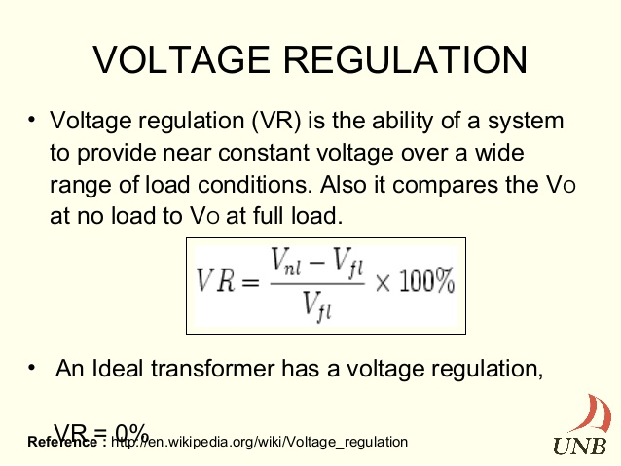
Voltage Regulation

Slide 21
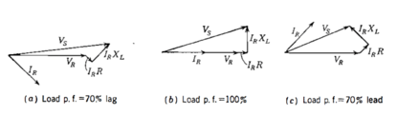

Regulation

Slide 22
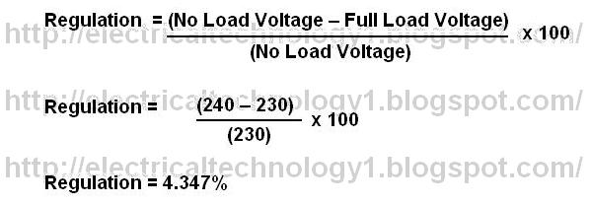
Calculation

Slide 23
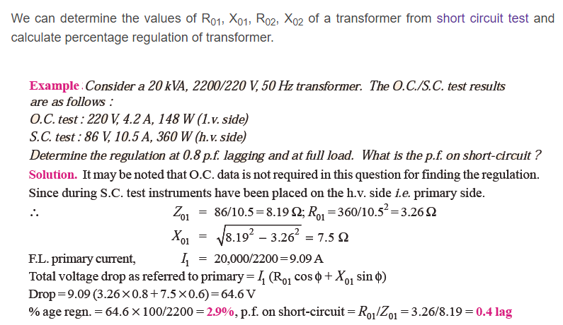
Example

Slide 24
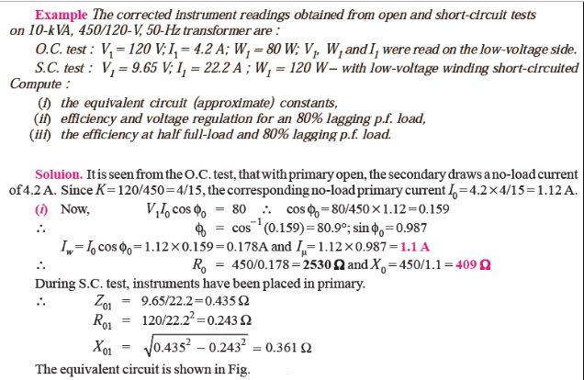
Example 2

Slide 25
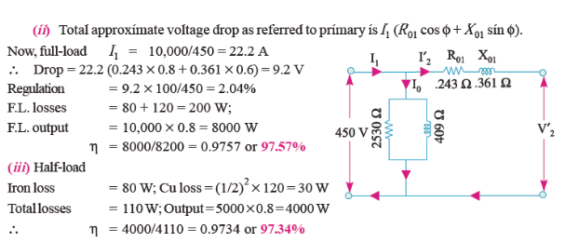

Slide 26

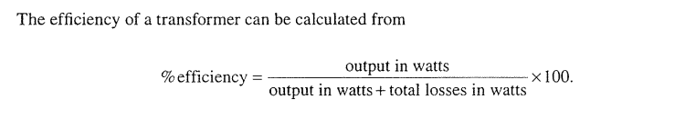
Transformer Efficiency
Efficiency is maximum when iron losses are equal to copper loss

Slide 27
Iron losses include (i) Hysteresis loss and (ii) Eddy current loss
The hysteresis loss is due to power requirements maintaining the continuous reversals of elementary magnets
The eddy current loss is due to circulating current in the iron core caused by varying fluxes in the iron
Eddy current loss is proportional to square of frequency and square of flux density

Slide 28
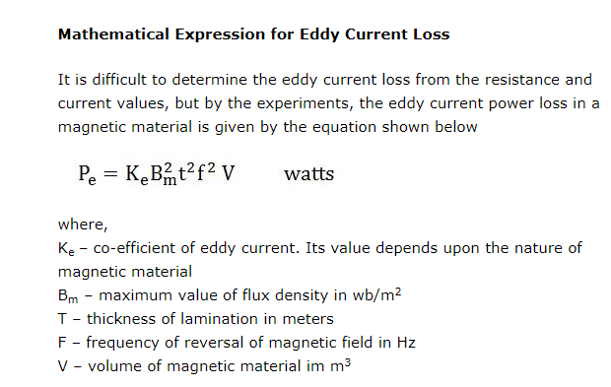

Slide 29
total hysteresis losses = Total area inside hysteresis loop*volume of core
According to Steinmetz’s formula, the heat energy dissipated due to hysteresis is given by
W_{h}=ηβ_{max}^{1.6} , and,
Hysteresis loss is thus given by
P_{h}≈ W_{h}f ≈ηfβ_{max}^{1.6}
Where, f is the frequency, η is the hysteresis coefficient and βmax is the maximum flux density, the empirical exponent of which varies from about 1.4 to 1 .8 depending on the material used for core but is often given as 1.6 for iron.

Slide 30
Problem
The load schedule for a 24-hr period on a 30-kva, 2400/240 v, 60-cycle transformer is as follows
Hours Kw PF
10 2.5 0.75
8 12.5 0.80
3 20.0 0.85
3 25.0 0.90
The data taken from open-circuit and short-circuit tests follow
High side open, measurements on low-voltage side
240 Volts
2.45 Amperes
154 Watts

Slide 31
Side short circuited, measurements on high side;
61.1 Volts
12.5 Amperes
706 Watts
Determine the energy efficiency for a daily load cycle?

Slide 32
Solution
The core losses are constant for the 24-hr period, and the energy dissipated in core loss is therefore
(154 x 24)/1000 = 3.70 kwhr
The load losses are proportional to the square of the current, i.e., to the square of the kva load
Energy dissipated in the load loss are computed in the following table;

Slide 33
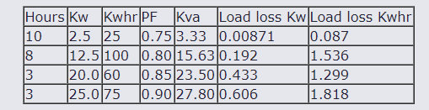

Slide 34
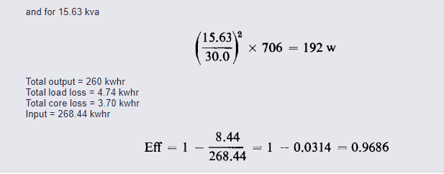
The load loss is proportional to the square of the kva load; hence, at 3.33 kva, the load loss is;
(3.33/30)² X 706= 8.71 Watts

Slide 35
Equivalent circuit of transformer
Fig in next slide is an equivalent circuit of a single phase two winding transformer
It represents a practical transformer with an iron core and connected to load (L)
When primary winding is excited, flux is produced in iron core
The flux that links both primary and secondary is called the mutual flux and its maximum value is denoted by φm
There are leakage fluxes φl1 and φl2 at primary and secondary winding

Slide 36
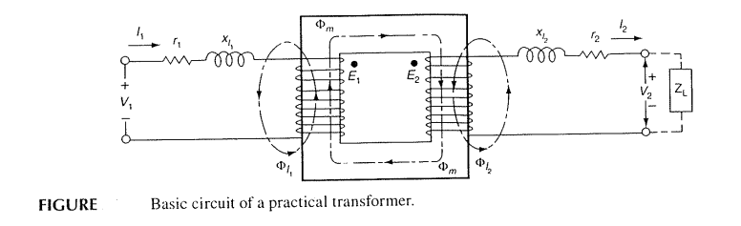

Slide 37
Xl₁ and Xl₂ are primary and secondary inductive reactance
r₁ and r₂ are primary and secondary resistances
Equivalent circuit of Loaded transformer
I₂’ current is a primary current or load component which exactly corresponds to secondary current I₂ as for ideal transformer,
I₂’ = n₂/n₁ X I₂
I₂ = I₂’/n
I_{e} is excitation current component of I₁ that is needed to produce the resultant mutual flux

Slide 38
I_{e} has two components , I_{m} is magnetizing current and Ic core loss current
R_{c} represents resistance of the equivalent transformer causing power loss due to (hysteresis and eddy current) iron losses of transformer
X_{m} is reactance due to magnetization current

Slide 39
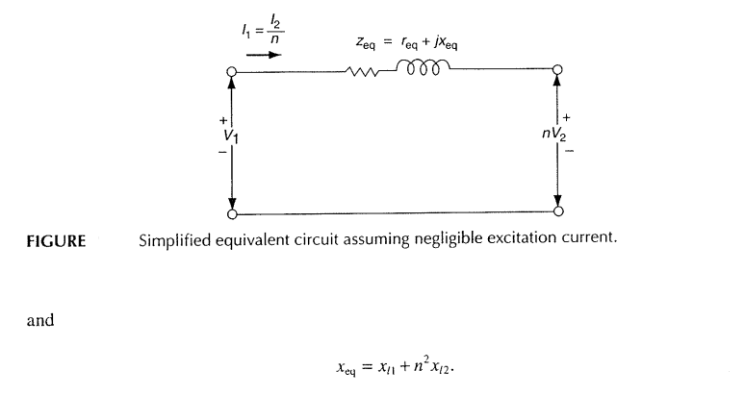

Slide 40
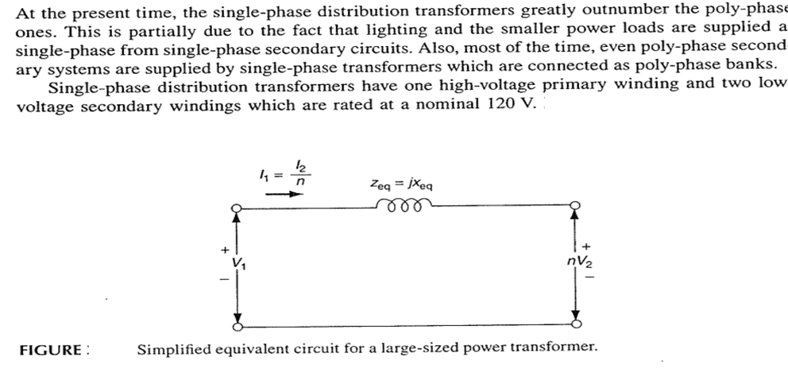
Single phase transformer Connections

Slide 41
Single Phase Transformer Paralleling
When greater capacity is required in emergency situations, two single phase transformers of the same or different KVA ratings can be connected in parallel
The single phase transformers can be either additive or subtractive polarity as long as the following conditions are observed and connected;
1- All transformers have the same turns ratio
2- All transformers are connected to the same primary phase
3- All transformers have identical frequency

Slide 42
4- All transformers have identical voltage rating
5- All transformers have identical tap setting
The various combinations of single phase transformer paralleling is given in next slide;

Slide 43
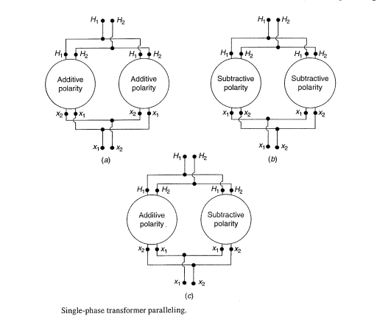

Slide 44
Auto Transformer
The usual transformer has two windings which are not connected to each other, whereas an autotransformer is a transformer in which one winding is connected in series with the other as single winding
It is like normal transformer connected in a special way
It is rated on the basis of output KVA
It has lower leakage reactance, lower losses, smaller excitation current requirements and cheaper than two winding transformer

Slide 45
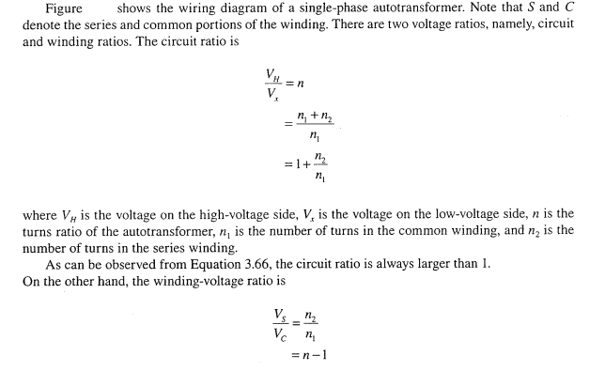

Slide 46
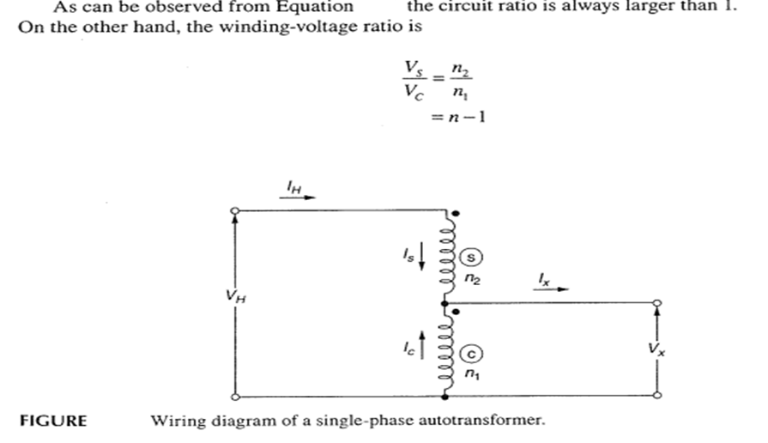

Slide 47
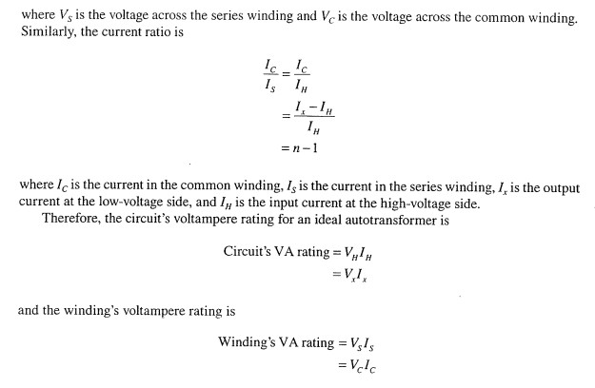

Slide 48
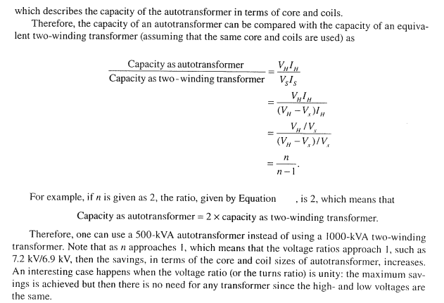

Slide 49
Next Lecture
Discussion will be on substations after problems

